Slide 1
Style Set - Retinal Vessel Segmentation With StyleGan Images
Nadav Potasman
Ariel Rechtman

Slide 2
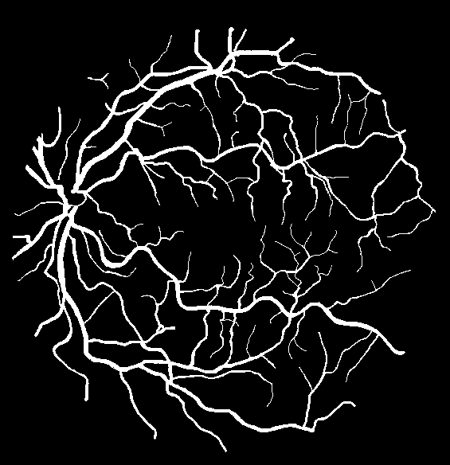
Problem Description
Segment blood vessels in medical retinal images
Vessels width may change in factor of 20
Very limited data – only 40 train images and 20 test
Neural Networks tend to overfitting

Slide 3
Why Is this problem hard?
Edge detection algorithm should do the job?
Noisy images
Very thin vessel
Classics methods not good enough for that mission
Edge detection result

Slide 4
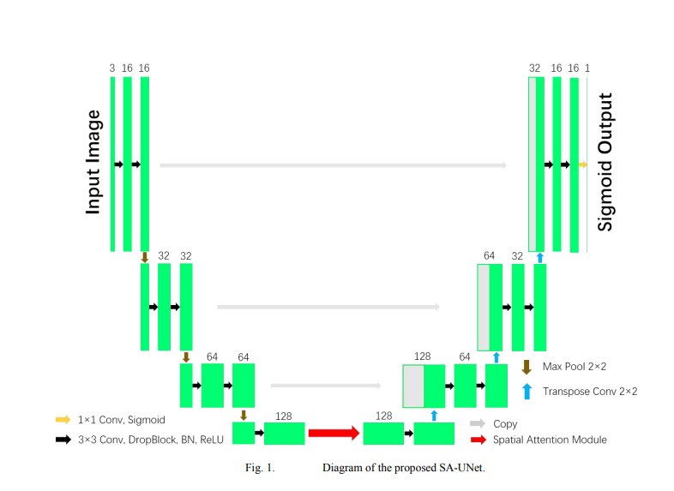
Spatial Attention U-Net
Difference from Unet: -Special Attention
-DropBlocks
Encoder
Decoder
“SA-UNet: Spatial Attention U-Net for Retinal Vessel Segmentation” [Changlu Guo at al. ICPR 2020]

Slide 5
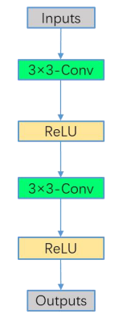
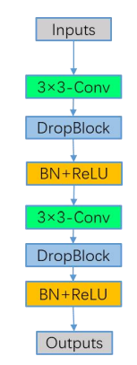

SA-Unet vs. Unet
Unet has overfitting problem, so instead of normal convolutional blocks, SA-Unet use DropBlocks, and Spatial Attention block
Dropout randomly discards features during training while DropBlock discards contiguous region of a feature map
Spatial Attention :
“SD-Unet: A Structured Dropout U-Net for Retinal Vessel Segmentation” [Changlu Guo et al. 2019 IEEE]
Original UNet Block
SA-UNet Block

Slide 6
Our Innovation – Using Style GAN2 + SA-UNet
Original Data Set (DRIVE)
Larger Data Set
(less Accurate Segmentation)
SA-Unet
(SOTA)
Train
Predict
Train
SA-Unet (Our)
StyleGan2

Slide 7
Our Work - Pipeline
Train the SOTA SA-Unet on DRIVE dataset
Train StyleGAN2 with transfer learning that pretrained on FFHQ dataset
Create 1,000 new images from StyleGAN2
Segmented the 1,000 StyleGAN2 images with the SA-Unet (from 1)
Train the new SA-Unet from StyleGAN2 and DRIVE images (many configuration)

Slide 8
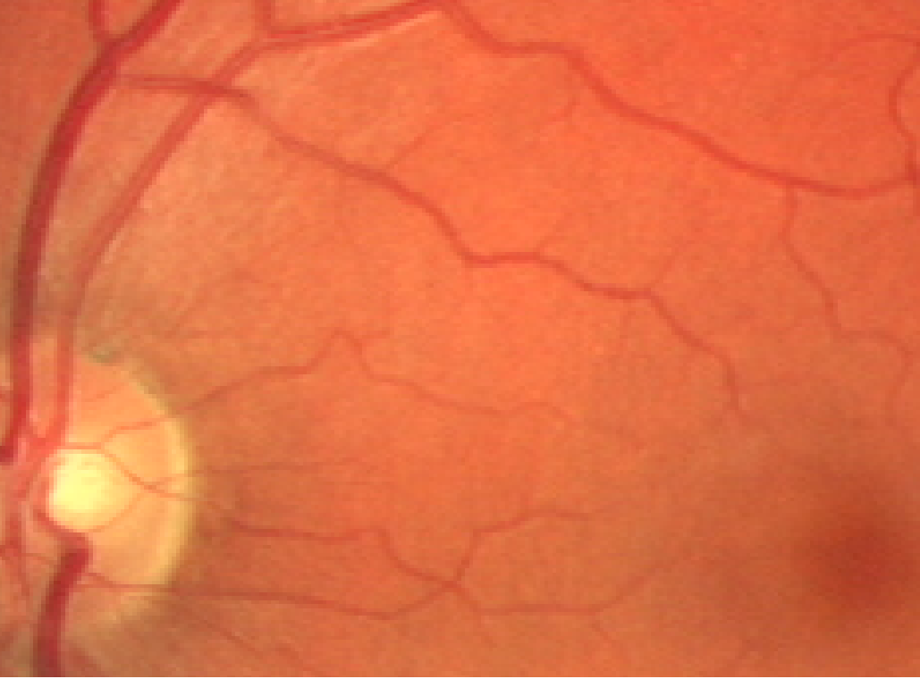
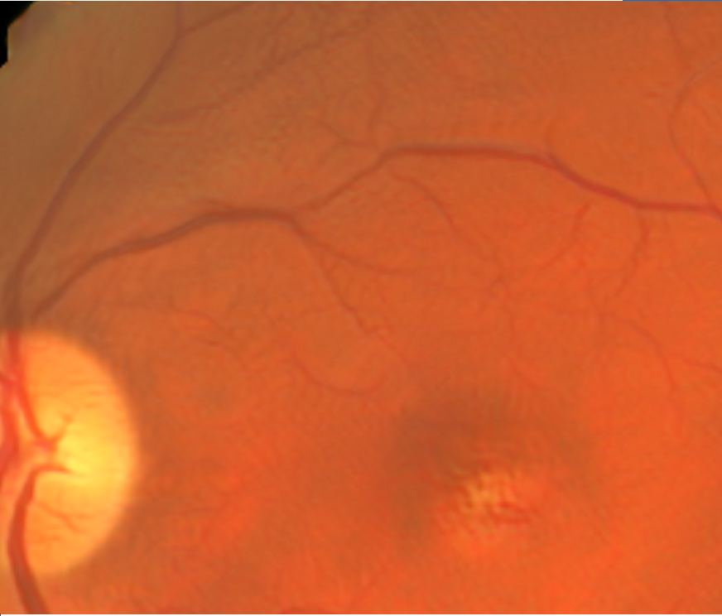
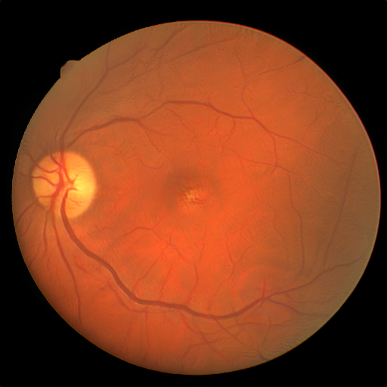
StyleGAN2 images vs. DRIVE images
Original images
StyleGAN2 images

Slide 9
Our result - Mid results
Precision | F1 | AUC | Accuracy | Specificity | Recall | Model
0.7839 | 0.8012 | 0.9789 | 0.9666 | 0.9857 | 0.7677 | Unet
0.8097 | 0.8263 | 0.9861 | 0.9698 | 0.9840 | 0.8212 | SA-Unet (paper)
0.8019 | 0.8820 | 0.9875 | 0.9686 | 0.9797 | 0.8530 | SA-Unet (implementation)
0.8891 | 0.9376 | 0.9776 | 0.9655 | 0.9917 | 0.7671 | Our Result

Slide 10
Our result – More results
Precision | F1 | AUC | Accuracy | Specificity | Recall | Model
0.8019 | 0.8820 | 0.9875 | 0.9686 | 0.9797 | 0.8530 | SA-Unet (implementation)
0.8891 | 0.9376 | 0.9776 | 0.9655 | 0.9917 | 0.7671 | Our Result
0.9689 | 0.9835 | 0.9402 | 0.955 | 0.9984 | 0.504 | Best F1
0.8726 | 0.9274 | 0.982 | 0.9674 | 0.9897 | 0.7352 | Alternative result

Slide 11
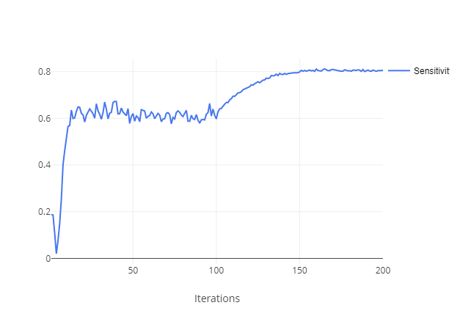
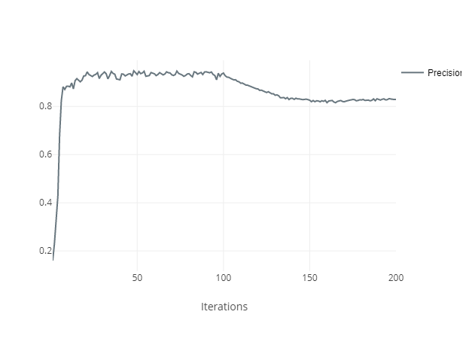
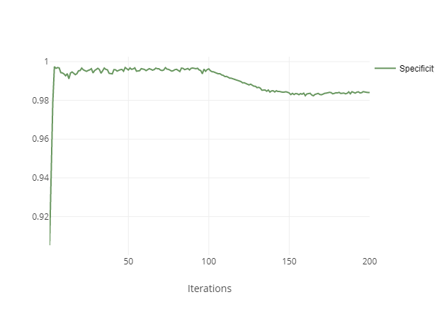
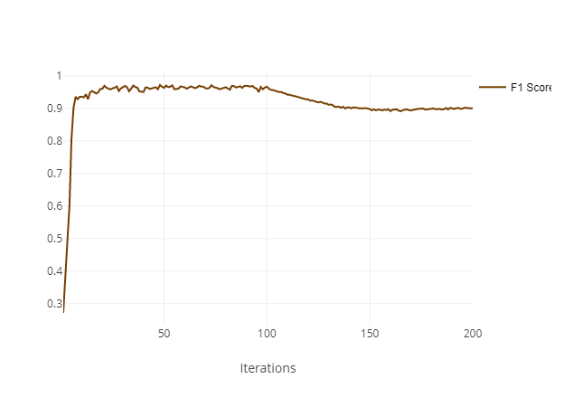
Result Analysis
Data switch

Slide 12
Images Examples
Train with GAN images only
Train without GAN images

Slide 13
Ensemble
Last we try to combine the fine details of ‘only original’ model with the success of large vessel segmentation of the GAN images model
We train network only on GAN images and a second network only on the original dataset
From those two NN we built naïve ensemble that combine the results of the networks
Precision | F1 | AUC | Accuracy | Specificity | Recall | Model
0.8019 | 0.8820 | 0.9875 | 0.968 | 0.9797 | 0.8530 | SA-Unet (implementation)
0.8891 | 0.9376 | 0.9776 | 0.9655 | 0.9917 | 0.7671 | Our Mid Result
0.887 | 0.9363 | 0.983 | 0.968 | 0.9911 | 0.7295 | Ensemble
0.734 | 0.835 | 0.985 | 0.968 | 0.982 | 0.888 | Ensemble - Recall

Slide 14
Further work
Manual segmentation correction of StyleGan2 images (before train)
Using DataSet GAN to create couple of image and segmentation
Making the process iterative
Create more sophisticated ensemble

